Slide 1
Analysis of Multics
CS 361S
Spring 2020
Seth James Nielson

Slide 2
Multics Security Evaluation: Vulnerability Analysis
Originally Published in June 1974
This was 10 years before Thompson’s paper
Computer security was already a concern in military circles

Slide 3
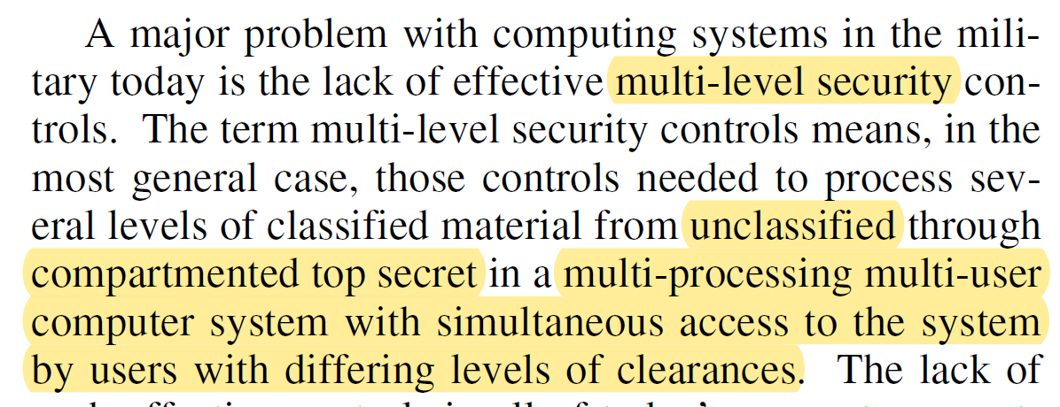
Genesis of the Paper

Slide 4
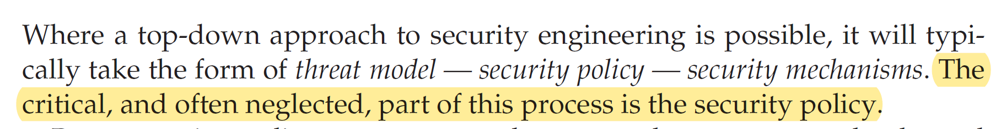
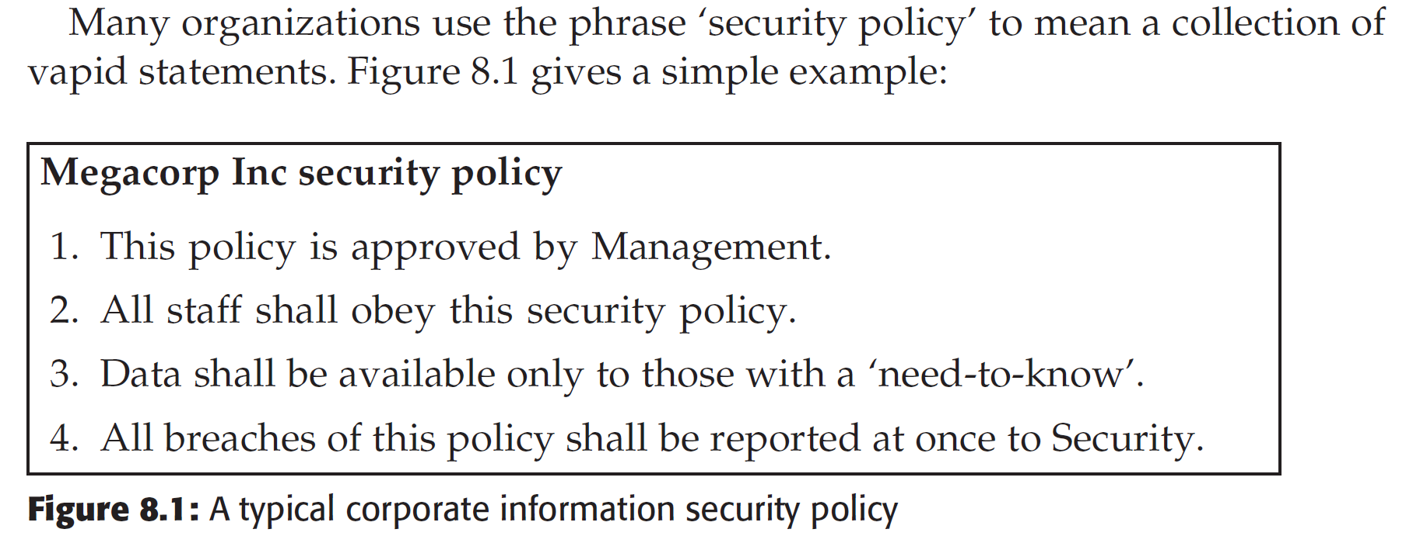
Detour to Anderson: Policy

Slide 5
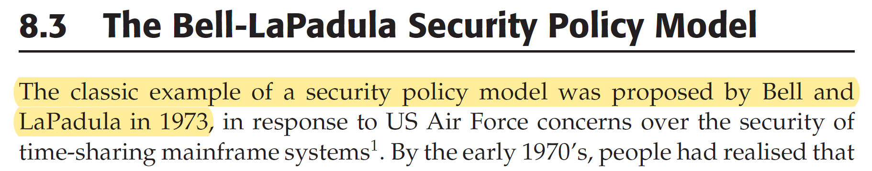
Anderson: Bell-LaPadula

Slide 6
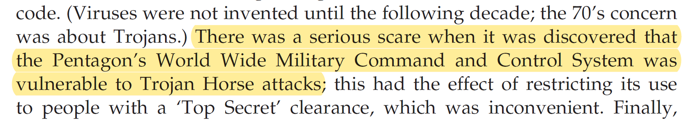
Anderson: Secure Systems Theory

Slide 7
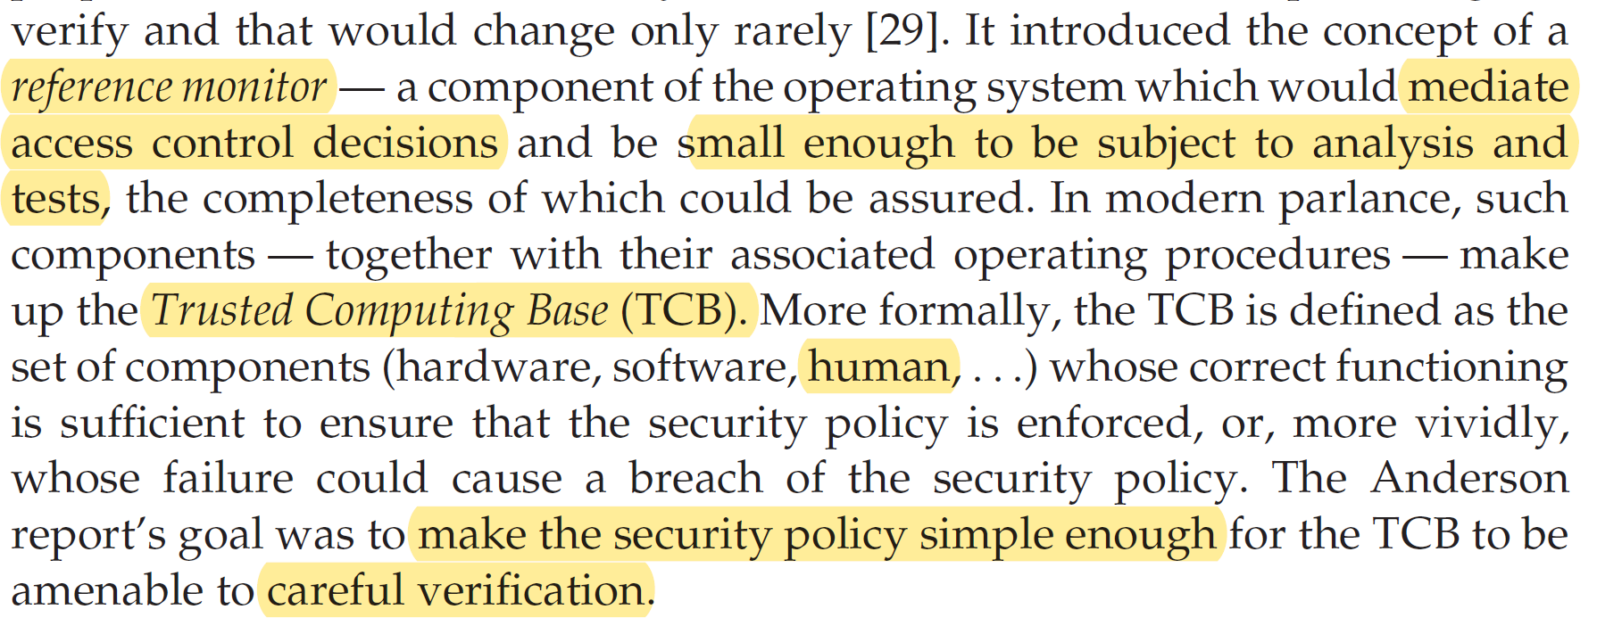
Anderson: Trusted Computing Base

Slide 8
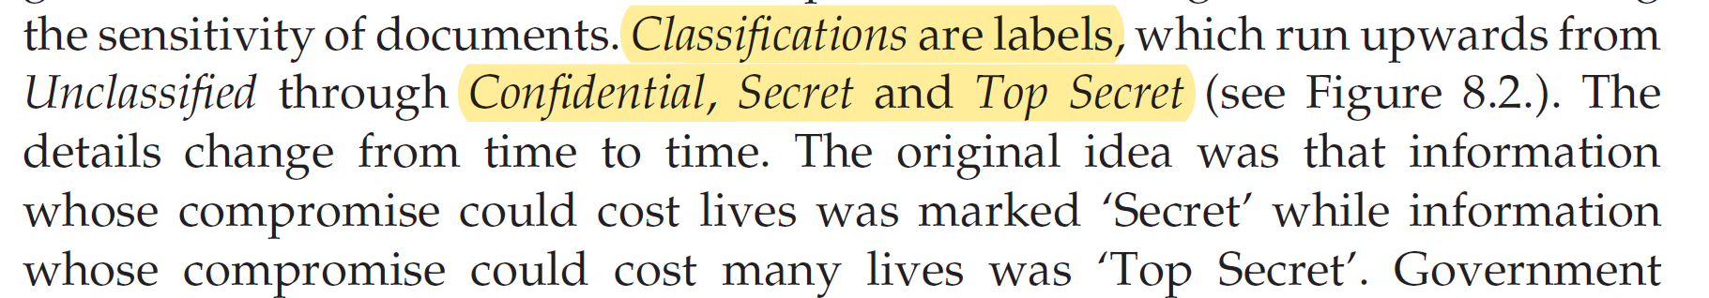
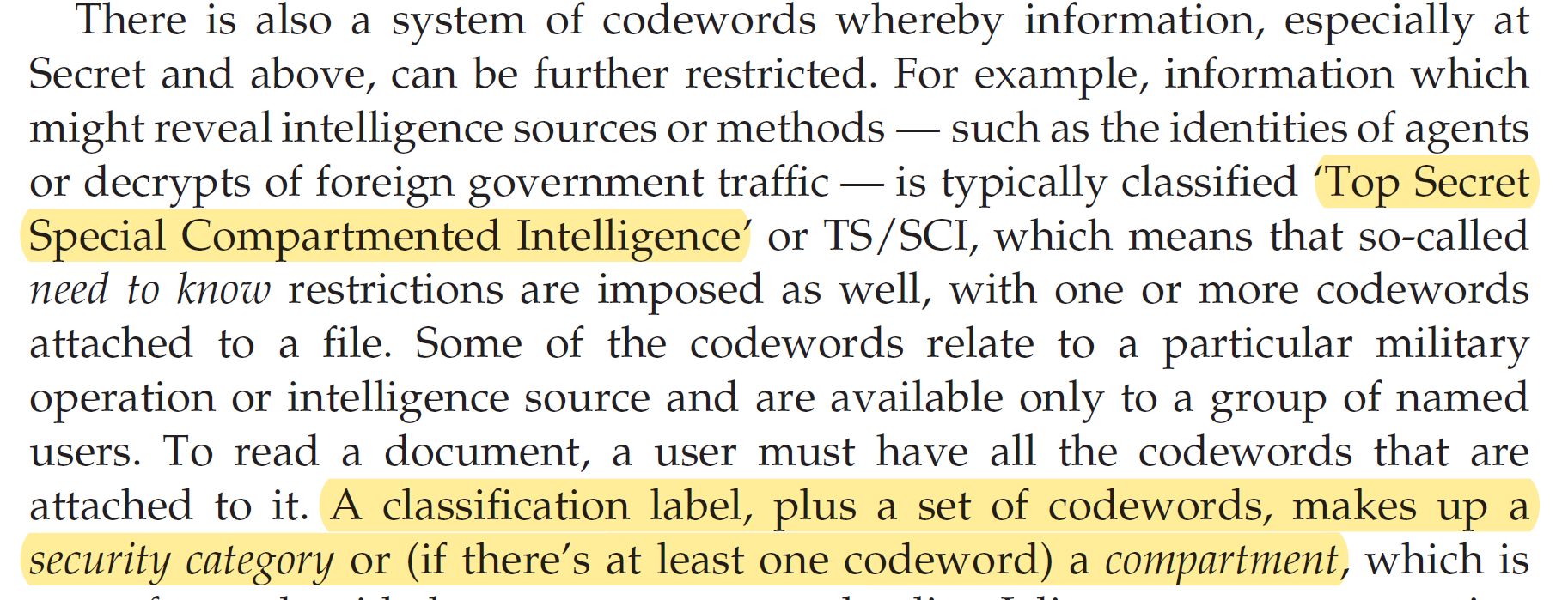
Anderson: Classification

Slide 9
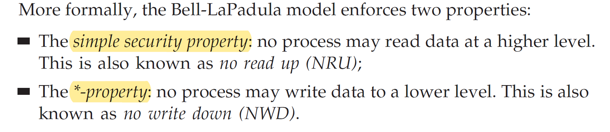
Anderson: Bell Lapadula Model

Slide 10
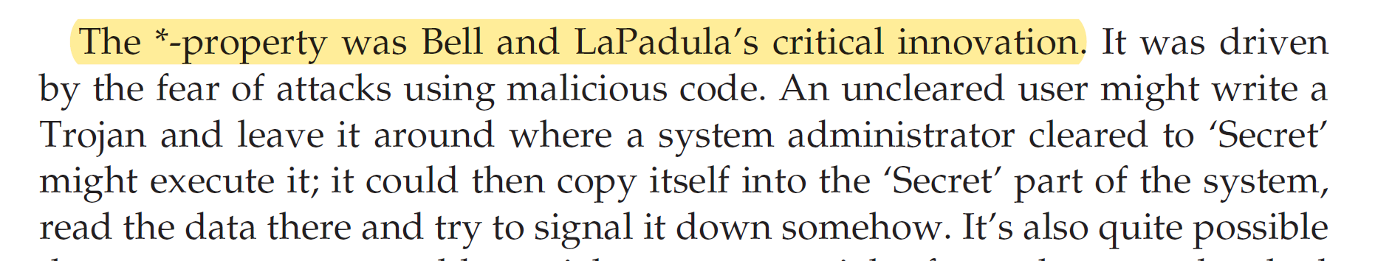
Anderson: *-Property

Slide 11
Policy vs Mechanism Vs Trust
Bell LaPadula says NOTHING about implementation
Implementation is the Mechanism for enforcement
Remember TRUST: elements that, if broken, result in violated policy

Slide 12
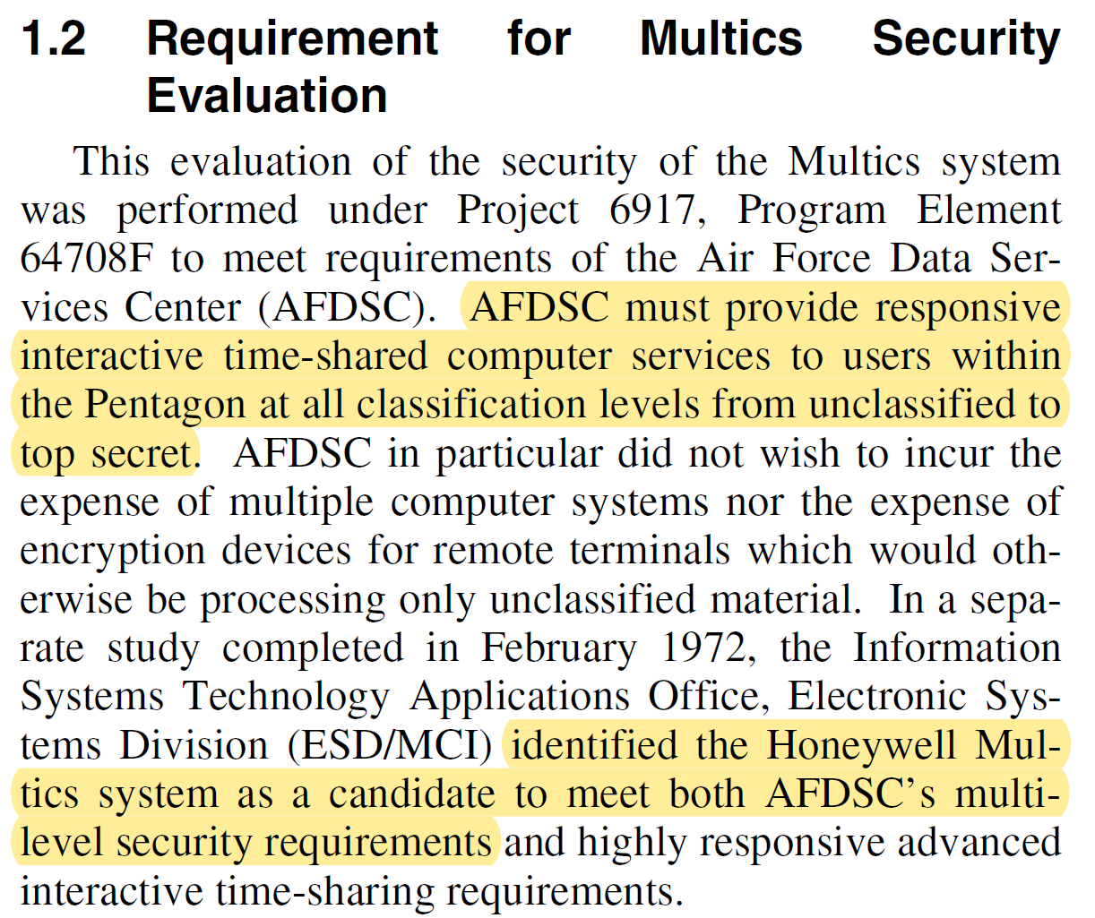
Back to Multics

Slide 13
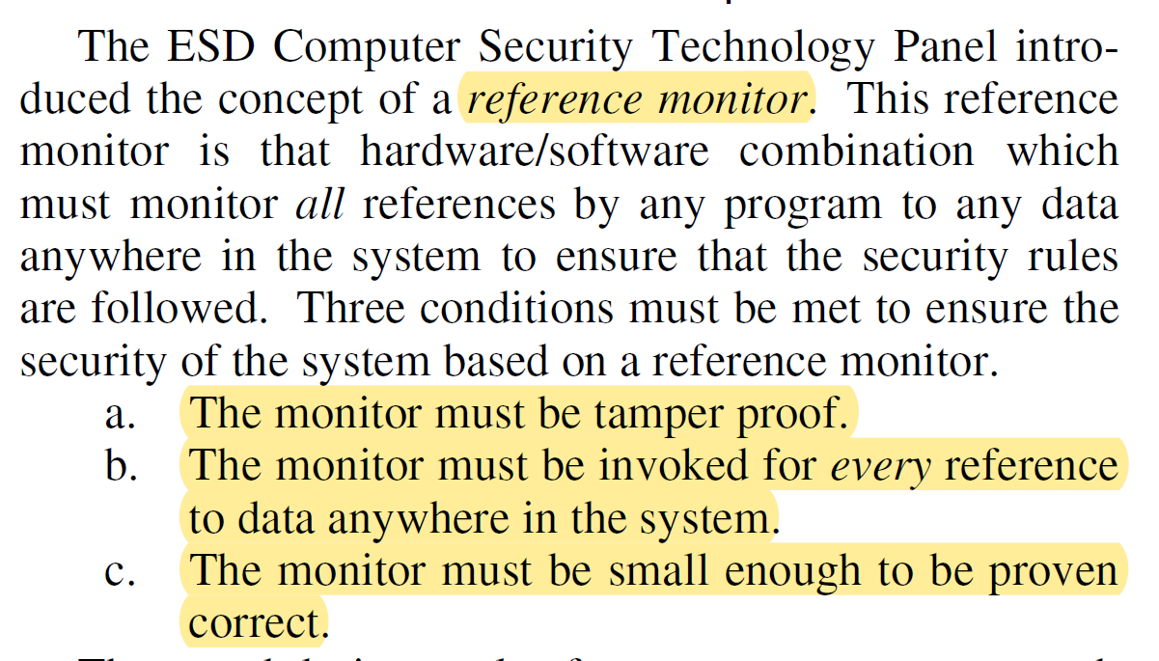
Reference Monitors Again

Slide 14
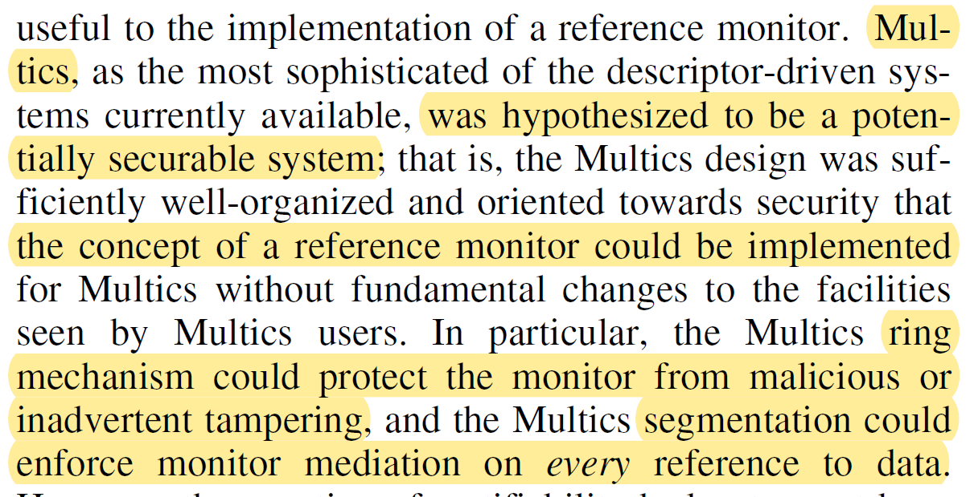
Multics Reference Monitor

Slide 15
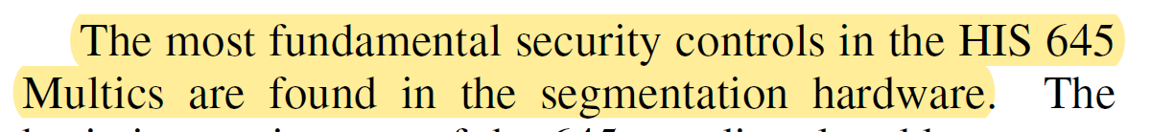
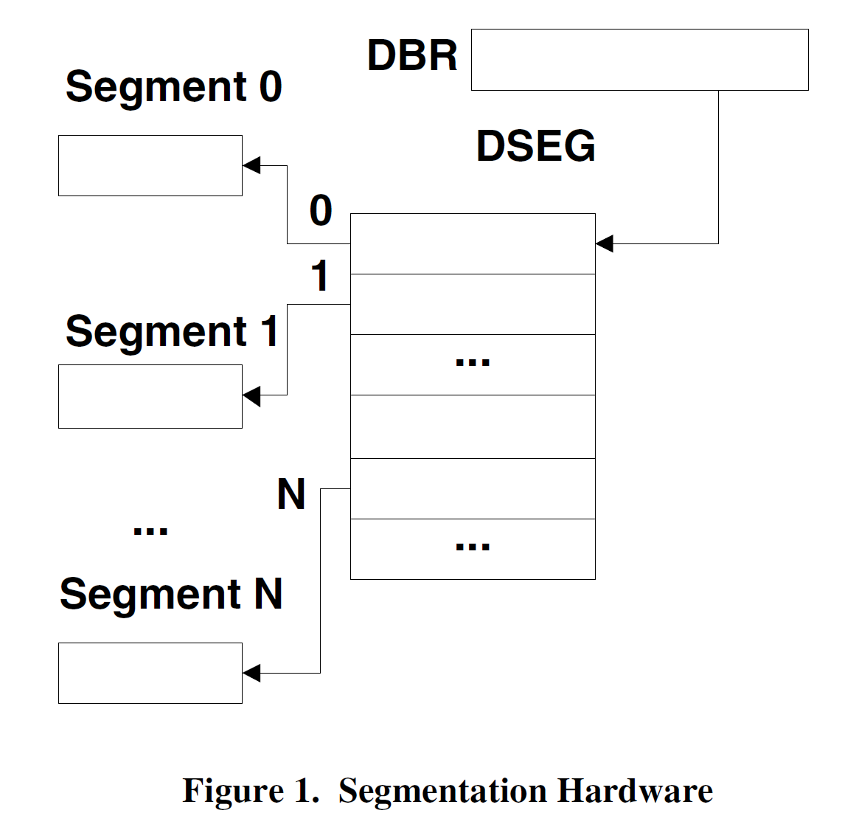
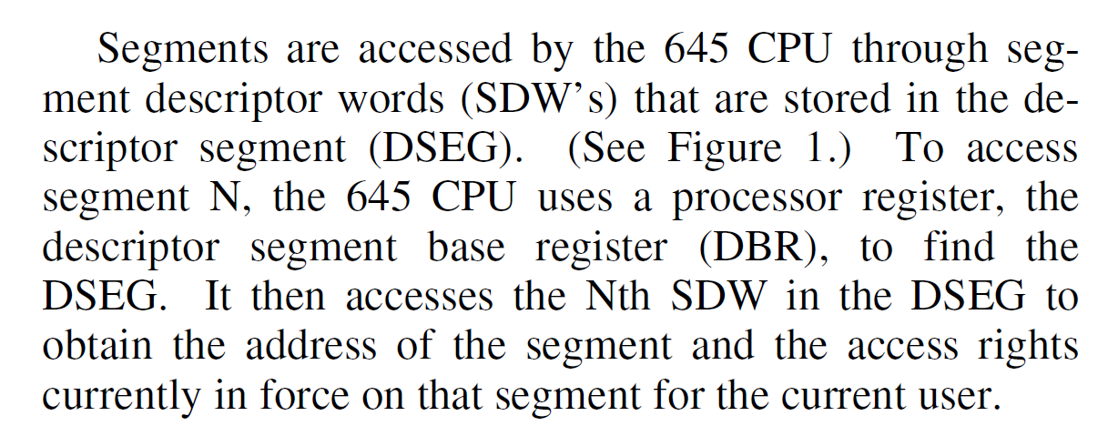
Segmentation

Slide 16
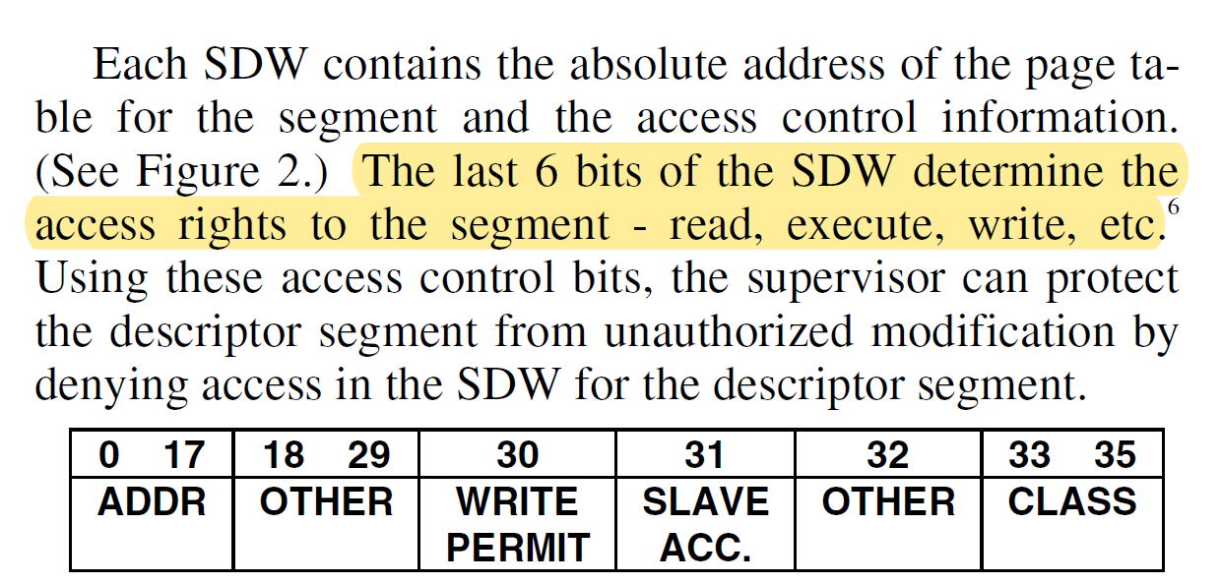
Segment Access Control

Slide 17
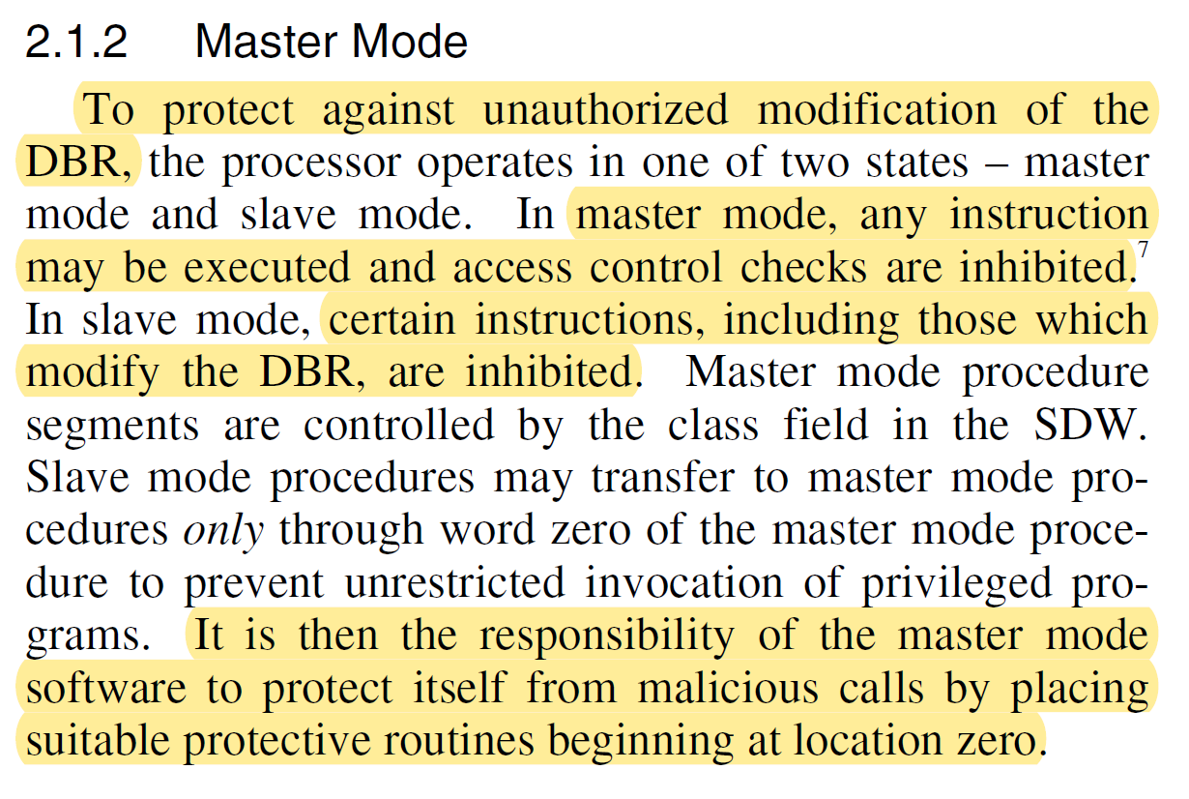
Master/Slave Mode

Slide 18
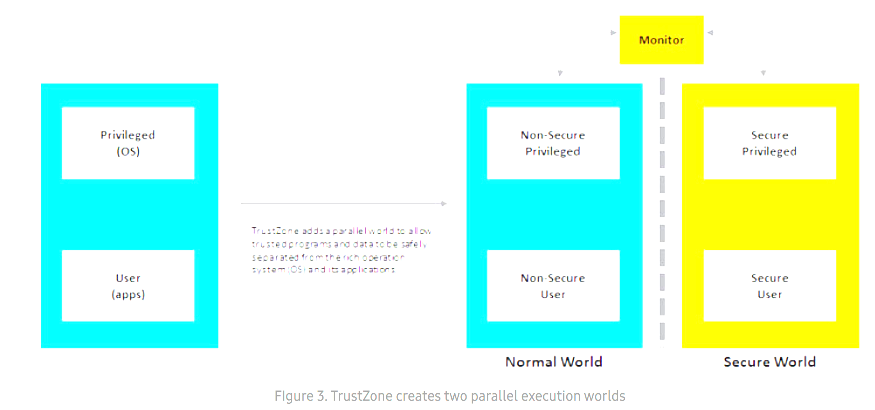
Detour: Arm TrustZone

Slide 19
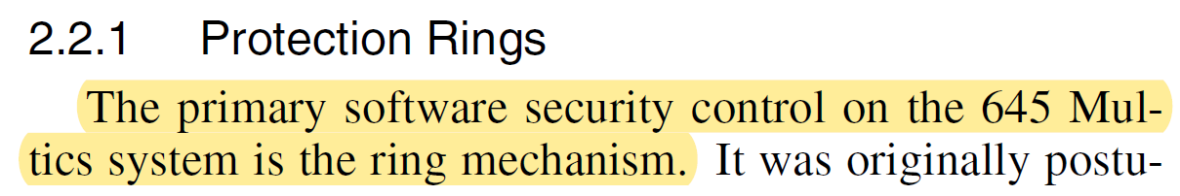
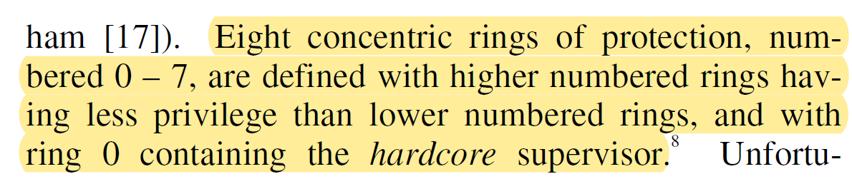
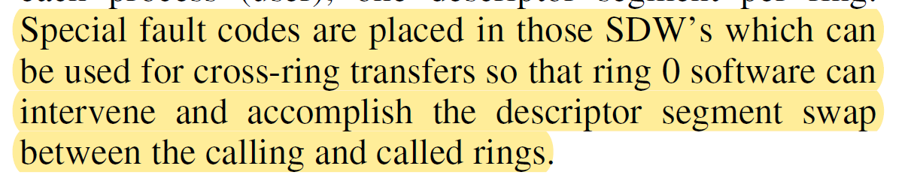
Rings

Slide 20
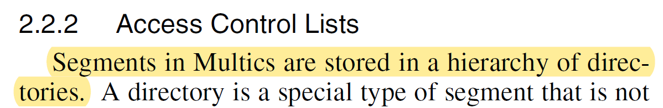
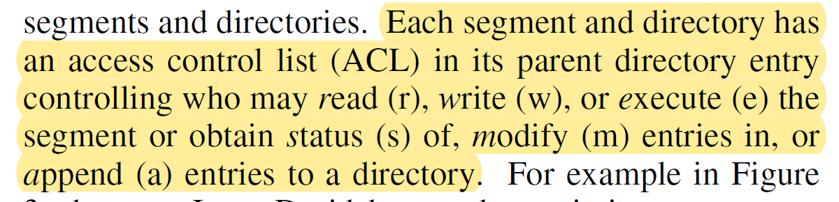
Access Control Lists (ACLs)

Slide 21
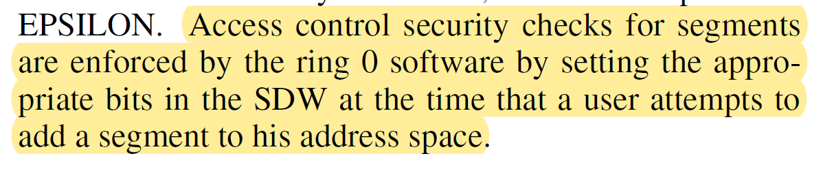
ACL Enforcement

Slide 22
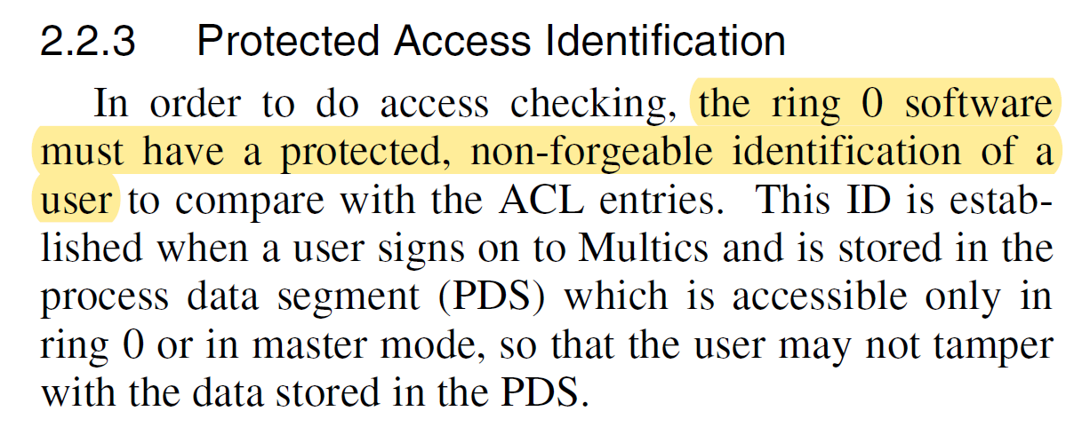
User Identification

Slide 23
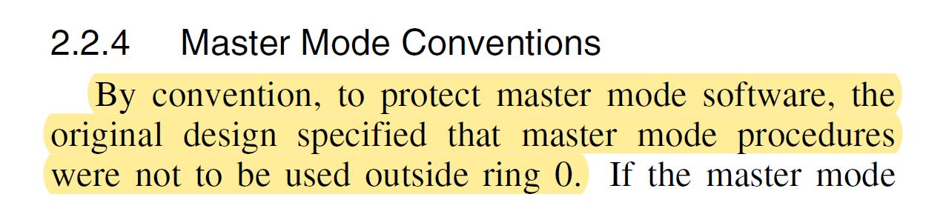
Master Mode Protection

Slide 24
Procedural Security
Encrypted Passwords
Login/Logout Audit Trail
Protected and auditable ring-0 software

Slide 25
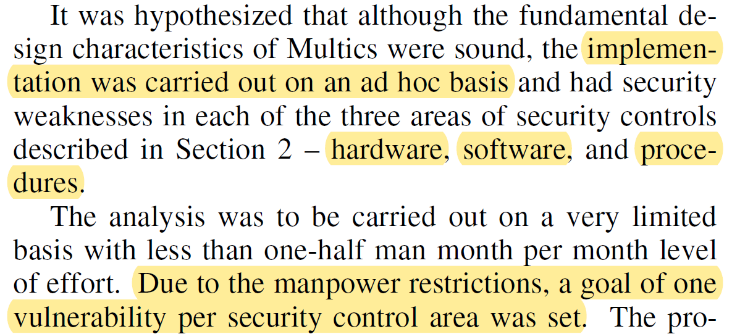
Vulnerability Analysis PLAN

Slide 26
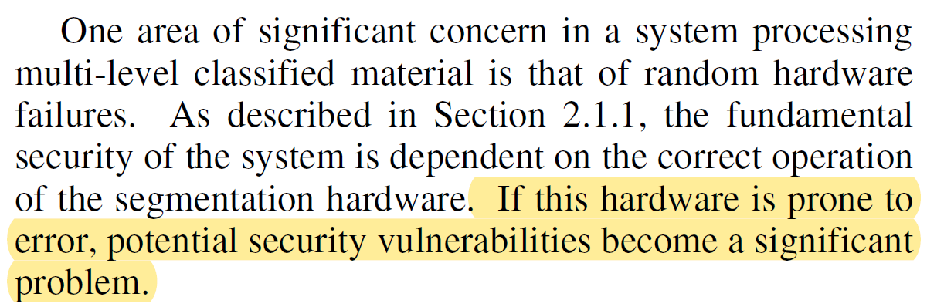
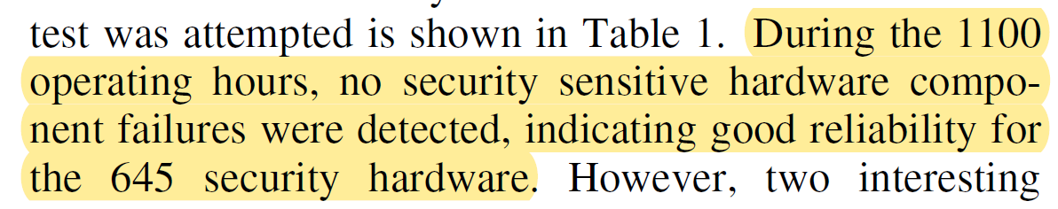
Random Hardware Failure Test

Slide 27
Detour: Reliability is NOT Security
This is NOT necessarily true. The Reliability of the hardware is not always a good indication of security/insecurity.

Slide 28
More about Reliability
In classical software engineering, reliability is key!
In security engineering, sometimes reliability is incorrectly used as a metric
How frequently the system fails is not typically what matters
Rather, small bugs that ALMOST NEVER HAPPEN are the problem!

Slide 29
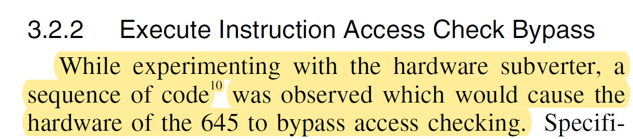
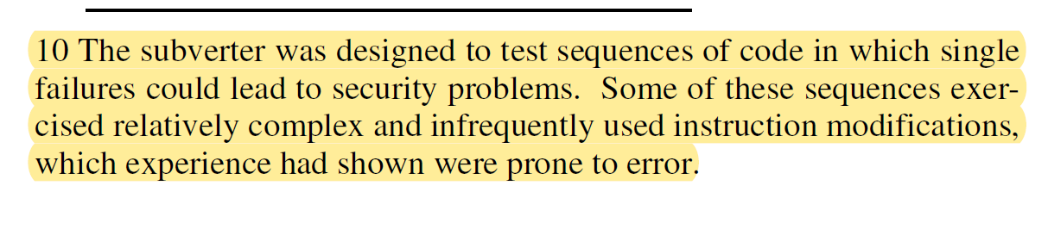
Vulnerability Found During Reliability Testing

Slide 30
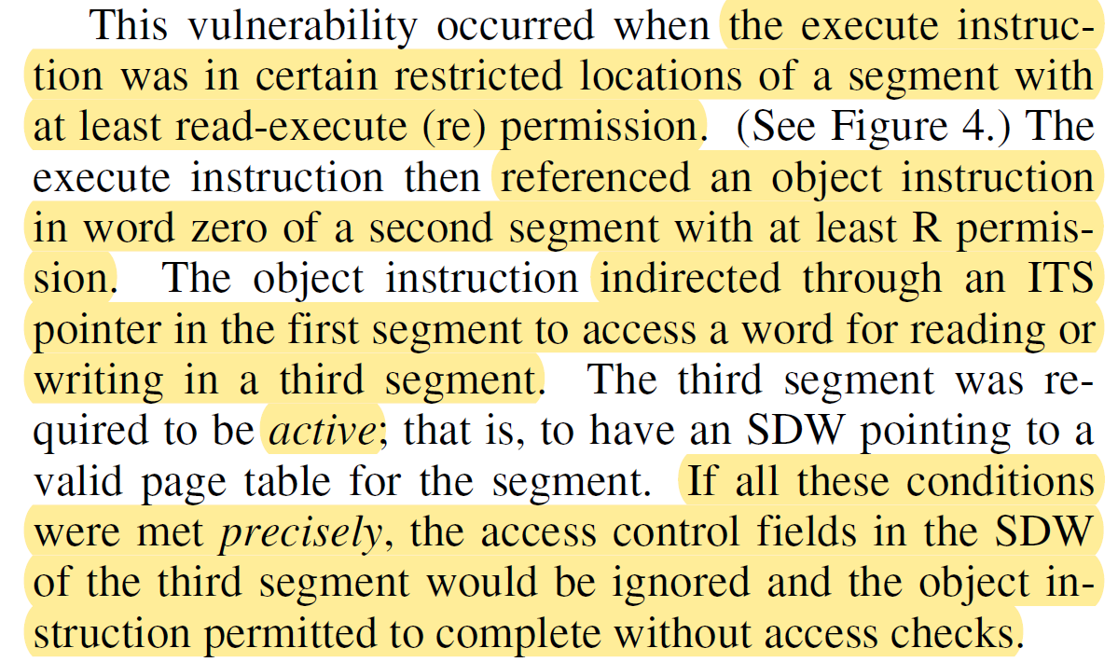
Sequence of Code

Slide 31
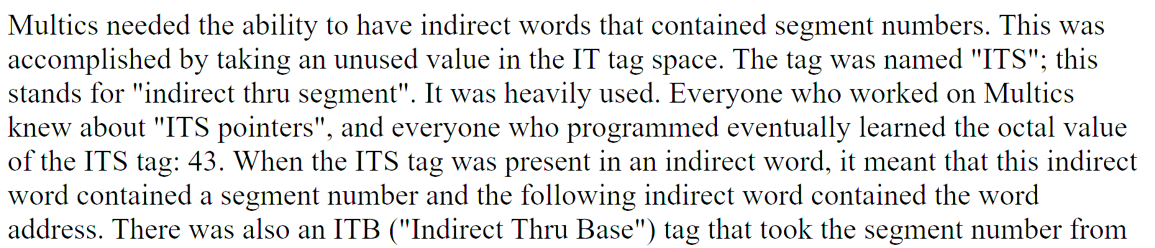
Detour: What is an ITS Pointer?

Slide 32
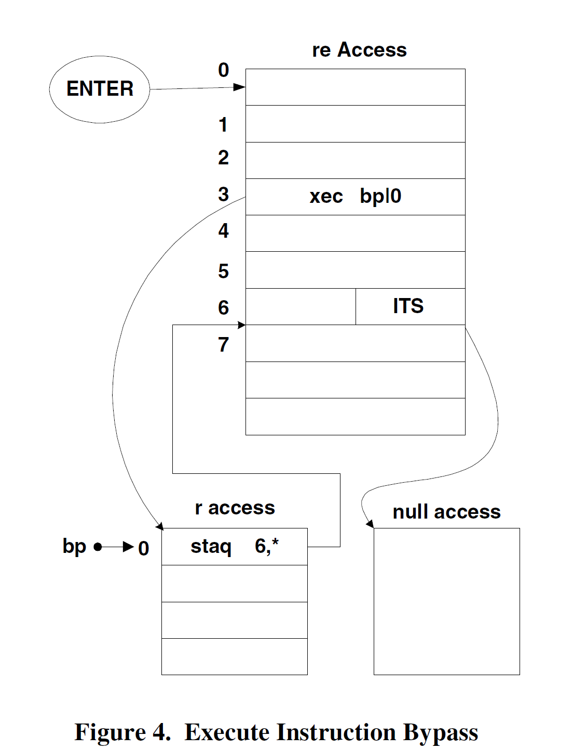
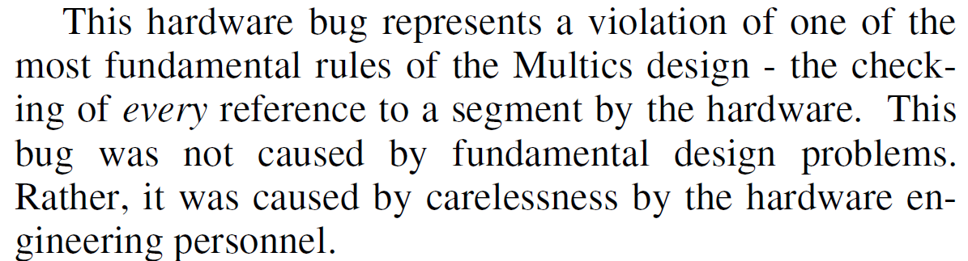

Slide 33
Detour: Fuzzing
The reliability tester was, unintentionally, a fuzzer
That is, it ran a bunch of unusual code sequences automatically
Although it was looking for reliability failures, it found a vulnerability

Slide 34
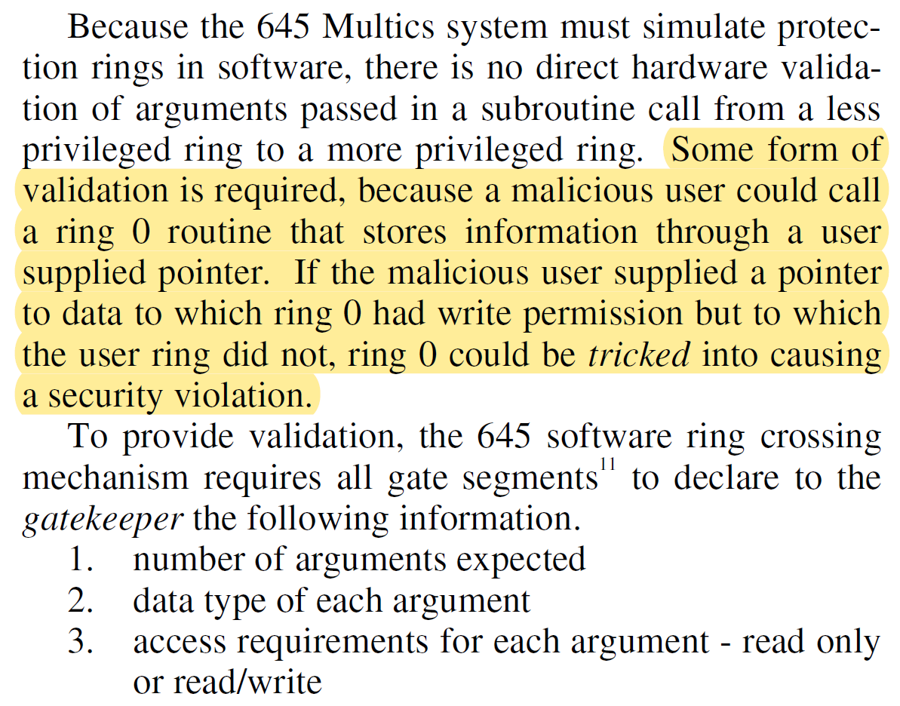
Ring-0 Tricked

Slide 35
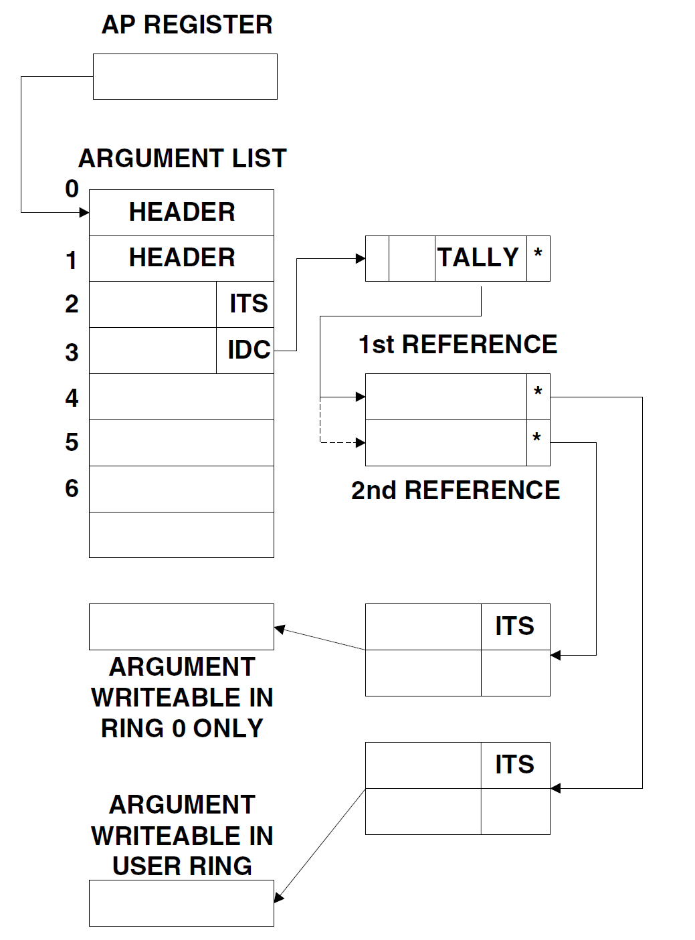
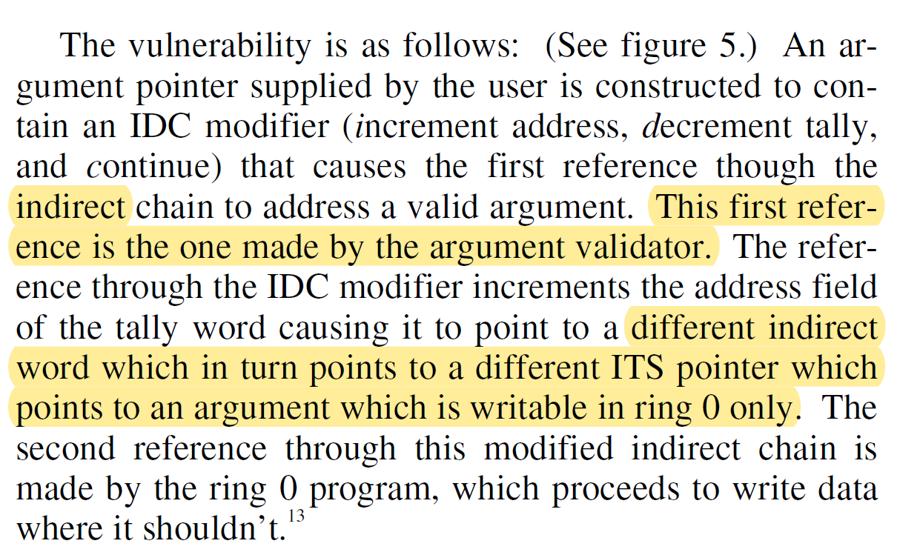
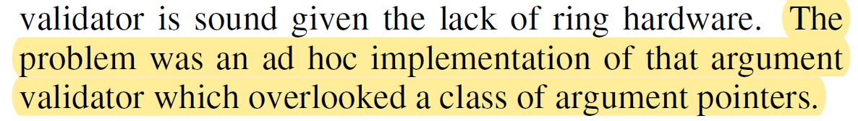
Violating Ring-0

Slide 36
Something Seems Familiar…
Isn’t this the second vulnerability via ITS?

Slide 37
Breaking into Master Mode
As stated previously, master mode should be ring-0 only
However, fault handling, which is master mode, was expensive
A signaler, which was master mode, was moved to the user ring

Slide 38
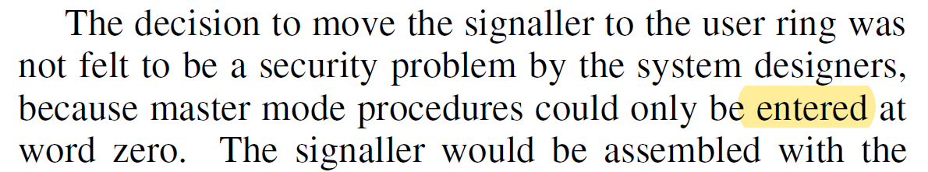
Security Rationale
In other words, so long as it started in ring-0, they were sure it was fine.

Slide 39
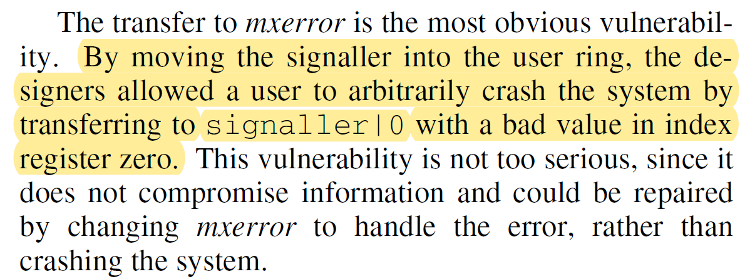
Vulnerability 1: Crashing

Slide 40
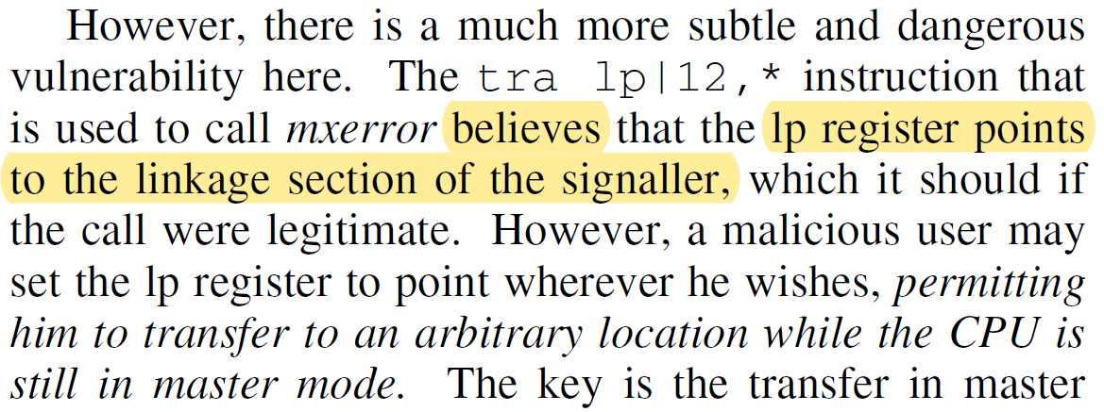
Vulnerability 2: Arbitrary Code

Slide 41
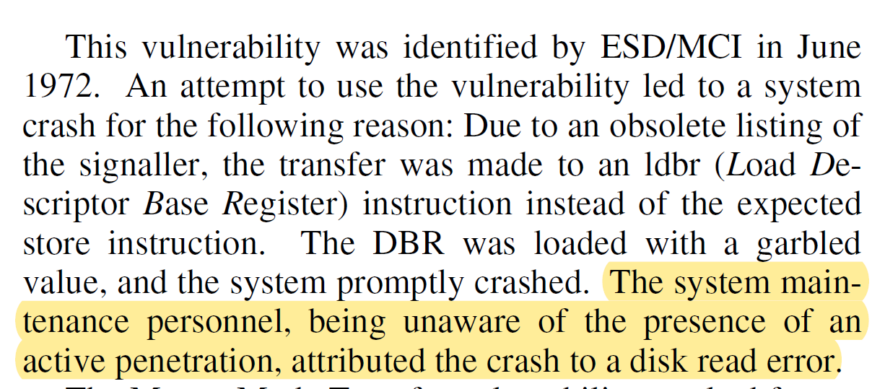
Assumptions Still

Slide 42
Unlocked Stack Base
Very briefly discuss here
Change in security design assumptions
Never fully updated the implementation to the new design

Slide 43
Dump and Patch
Multics can re-write all of memory while it is running
(BTW, if that sounds bad, all modern O/Ss can too, including device drivers)
These utilities are supposed to be ring-0 only
Using the previously described vulnerabilities, were run in user ring

Slide 44
Other Vulnerabilities
Using Dump and Patch, it is possible to become “anyone” (forged ID)
Access to the password file through forged ID
Modifying Audit trails, through forged ID
Insertion of Trap Doors, using forged ID

Slide 45

One Attack Builds To Another
Unlocked Stack Base plus Insufficient Argument Validation…
Leads to Dump and Patch…
Leads to Forged ID…
Leads to password file access, trojans, etc

Slide 46
Summary
We did not have time to review every attack in deep detail
We focused on certain attacks if they were difficult to understand
Or if they had important pedagogical value
Or if they are related to contemporary security concerns

